Slide 1

Lecture 21: Dynamic Programming
Answer the Warm Up:
PollEv.com/champk
CSE 373: Data Structures and Algorithms

Slide 2
Warm Up
Answer the Warm Up:
PollEv.com/champk
Apply Bucket Sort and Radix Sort to the sequence
[7625, 5002, 6746, 7403, 2266, 5532, 2010]
Radix
Bucket
1 scatter to buckets, perform insertion on each bucket, gather buckets
4 phases of scatter from list to buckets based on each digit place in the entries
0 | 2010
1
2 | 5002, 5532
3 | 7403
4
5 | 7625
6 | 6746, 2266
7
8
9
0 | 5002, 7403
1 | 2010
2 | 7625
3 | 5532
4 | 6746
5
6 | 2266
7
8
9
0 | 5002, 2010
1
2 | 2266
3
4 | 7403
5 | 5532
6 | 7625
7 | 6746
8
9
0
1
2 | 2010, 2266
3
4
5 | 5002, 5532
6 | 6746
7 | 7403, 7625
8
9
0
1
2 | 2266, 2010
3
4
5 | 5002, 5532
6 | 6746
7 | 7625, 7403
8
9
0
1
2 | 2010, 2266
3
4
5 | 5002, 5531
6 | 6746
7 | 7625, 7403
8
9

Slide 3
Announcements
EX 5 due Tuesday (tomorrow)
EX 6 releases Tuesday (sorting)
EX 7 releases a week from Tuesday (last exercise)
Final exam THIS Friday!
TA lead exam review Wednesday GWN 301 from 6-8:30 PM
Check out the Final Exam Prep post on Ed
Question Thread

Slide 4
Sorting Summary

Slide 5
Radix Sort
Radix = “the base of a number system”
We will use “10” as we are comfortable with 10 based systems
Could use any value, such as 128 for ASCII strings
Idea
Bucket sort on one digit at a time
Only works on sequences of countable data: ints, doubles, stings
Number of buckets = radix
Start with least significant digit, do one pass of bucket sort per digit
Fun fact: invented in 1890 as part of US census
Input:
[170, 45, 75, 90, 802, 24, 2, 66]
ones:
[170, 90, 802, 2, 24, 45, 75, 66]
tens:
[802, 2, 24, 45, 66, 170, 75, 90]
hundreds:
[2, 24, 45, 66, 75, 90, 170, 802]
Example Walk Through Video

Slide 6
Radix Sort
[478, 537, 9, 721, 3, 38, 143, 67]
[721, 3, 143, 537, 67, 478, 38, 9]
[3, 9, 721, 537, 38, 143, 67, 478]
0
1 | 721
2
3 | 3, 143
4
5
6
7 | 537, 67
8 | 478, 38
9 | 9
0 | 03, 09
1
2 | 721
3 | 537, 38
4 | 143
5
6 | 67
7 | 478
8
9
0 | 003, 009, 038, 067
1 | 143
2
3
4 | 478
5 | 537
6
7 | 721
8
9
O(n)
O(n)
O(n)
O(n)
O(n)
O(n)
[3, 9, 38, 67, 143, 478, 537, 721]

Slide 7
Sorting: Summary
What does Java do?
Actually uses a combination of 3 different sorts:
If objects: use Merge Sort* (stable!)
If primitives: use Dual Pivot Quick Sort
If “reasonably short” array of primitives: use Insertion Sort
Researchers say 48 elements
Key Takeaway: No single sorting algorithm is “the best”!
Different sorts have different properties in different situations
The “best sort” is one that is well-suited to your data
 | Best-Case | Worst-Case | Space | Stable
Selection Sort | O(n²) | O(n²) | O(1) | No
Insertion Sort | O(n) | O(n²) | O(1) | Yes
Heap Sort | O(n) | O(nlogn) | O(n) | No
In-Place Heap Sort | O(nlogn) | O(nlogn) | O(1) | No
Merge Sort | O(nlogn) | O(nlogn) | O(nlogn) O(n)* optimized | Yes
Quick Sort | O(nlogn) | O(n²) | O(n) | No
In-place Quick Sort | O(nlogn) | O(n²) | O(1) | No
Bucket Sort | O(n) | O(n²) | O(K+n) | Yes
Radix | O(n) | O(n) | O(n) | Yes
* They actually use Tim Sort, which is very similar to Merge Sort in theory, but has some minor details different

Slide 8
What Else is There?
Can we do better than n log n?
For comparison sorts, NO. A proven lower bound!
Intuition: n elements to sort, no faster way to find “right place” than log n
However, niche sorts can do better in specific situations!
Many cool niche sorts beyond the scope of 373!
Counting Sort (Wikipedia)
External Sorting Algorithms (Wikipedia) - For big data™

Slide 9
Intro to Dynamic Programming
Fibonacci Problem
Staircase Problem
Box Problem
Knapsack Problem

Slide 10
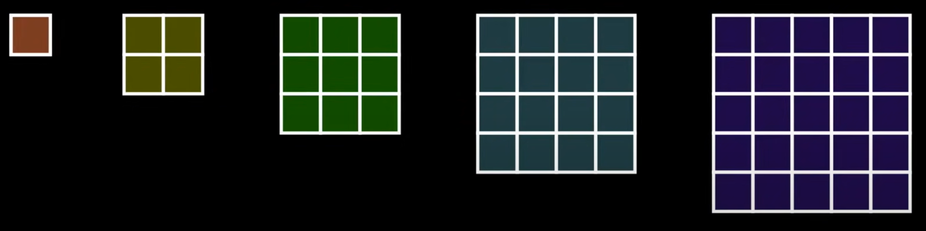

What is Dynamic Programming
An algorithmic technique of optimizing a given algorithm by:
Identifying the final solution as a summation of solutions to smaller sub problems
Building off of “divide and conquer”
Intelligently ordering our solutions to the sub-problems to build up to the final solution

Slide 11
Dynamic Programming Techniques
Design “brute force” recursive solution
Take a recursive algorithm and find the overlapping subproblems, then cache the results for future recursive calls. (Memoize)
Store subproblems of the main problem so we don’t have to re-compute them when we need them later on in solving the main problem
Bottom up approach
A little confusing? Don’t worry, you are not alone!

Slide 12
Intro to Dynamic Programming
Fibonacci Problem
Staircase Problem
Box Problem
Knapsack Problem

Slide 13
Question
Given a number n, print n-th Fibonacci Number.
Fibonacci(n) = Fibonacci(n-1) + Fibonacci(n-2)
How can we solve this problem in the most optimized way?
Notes:
HEAP!

Slide 14
Clarify
Can n be a non-positive number?
Depends, n can be 0, but not negative.
Can we use additional data structures?
Yes, assume we want the fastest overall runtime.
What should be the result when n = 0?
The result should be 0, before the first 1 in the sequence 1, 1, 2, …,Fib(n)

Slide 15
Example
Middle Case 1:
n = 2; Fib = 1, 1
Output = 1
Middle Case 2:
n = 9; Fib = 1, 1, 2, 3, 5, 8,
13, 21, 34
Output = 34
Edge Case 1:
n = 0; Fib = None
Output = 0
Edge Case 2:
n = 1; Fib = 1
Output = 1

Slide 16
Approach
Brute Force:
Use a recursive function to solve
Starting with n and descending down, recursively return the addition of the last and second to last numbers of our sequence
End our recursion when we hit our base case n = 1
Has O(2^{n}) runtime with O(n) space complexity…
There is a faster way using Dynamic Programming…

Slide 17

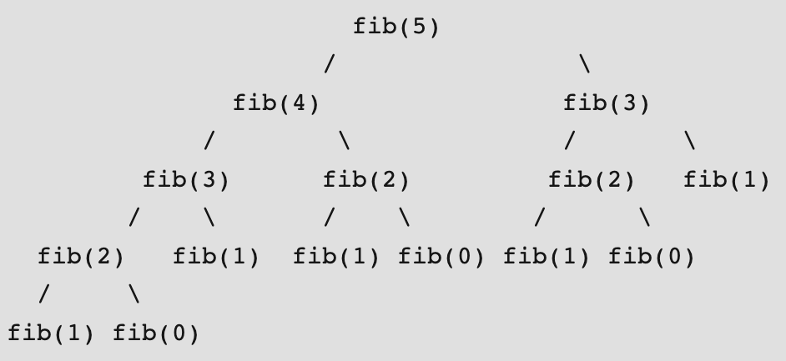
Recursive Solution
public static int fib(int n) {
if (n <= 1) {
return n;
}
return fib(n-1) + fib(n-2);
}
Brute Force solution, gets the job done

Slide 18

Memoized Dynamic Programming Solution
* because of pass by reference for Arrays there is only ever one array and we are simply returning the reference to the updated Array, not remaking it with each recursive call
public int fib(int n, int[] memo) {
if (memo[n] != -1) {
return memo[n];
} else if (n == 0 || n == 1) {
return 1;
} else {
int result = fib(n-1) + fib(n-2);
memo[n] = result;
return result;
}
}
* if working with a primitive value, you will need to fill the memo with something you can test for, if the memo is storing Objects you can make this check if the element is not NULL
memo[] =
0 | 1 | 2 | 3 | 4 | 5
0 | 1 | 1 | 2 | 3 | 5
2n+1 recursive calls gives us O(n) instead of O(2^{n})
Improved solution
Detailed walkthrough of this solution

Slide 19

Bottom Up Tabulation Solution
public int fib(int n) {
int f[] = new int[n+1];
f[1] = 1;
f[2] = 1;
for (int i = 3; i <= n; i++) {
f[i] = f[i-1] + f[i-2];
}
return f[n];
}
No more recursion!
Iteratively calculate solutions from bottom (base case) up to desired n
Detailed walkthrough of this solution
MORE Optimized solution

Slide 20

Bottom up and Reduce storage
public int fib(int n) {
int a = 0, b = 1, c;
if (n == 0)
return a;
for (int i = 2; i <= n; i++) {
c = a + b;
a = b;
b = c;
}
return b;
}
Recognize you only need the two most recent calculations for the final result
Allow your code to “forget” previous calculations when no longer needed
MEGA Optimized solution

Slide 21
Intro to Dynamic Programming
Fibonacci Problem
Staircase Problem
Box Problem
Knapsack Problem

Slide 22
Question
You are climbing a staircase. It takes n steps to reach the top.
Each time you can either climb 1 or 2 steps. In how many distinct ways can you climb to the top?
How can we solve this problem in the most optimized way?
Notes:
HEAP!

Slide 23
Example
Edge Case 1:
n = 1;
1) Take one step forward.
Output = 1
Edge Case 2:
n = 2;
1) 1 + 1 step
2) 2 steps
Output = 2
Middle Case:
n = 3;
1) 1 + 1 + 1 steps
2) 1 + 2 steps
3) 2 + 1 steps
Output = 3

Slide 24
Approach
Brute Force:
Use a recursive function to solve
Starting with n and descending down, recursively return the sum of the combinations it took to get to the last and second last steps from our current step
End our recursion when we hit our base cases n = 1, n = 0
Has O(2^{n}) runtime with O(n) space complexity…unless…dynamic programming…

Slide 25
Optimize
Optimized: Use Dynamic Programming to pre-compute the combinations of steps it takes to get to n and return. Runs in O(N) runtime.
Optimized no additional data structure: We compute the value of our current step with a fixed number of elements (our last and second last step it took to get to our current step). O(1)
Note: We are computing a value in a sequence, just like the Fibonacci problem…

Slide 26
Implement
Create 3 variables to hold the number of combinations it took to get to our second last step, our last step, and our current step with respect to our current step in the sequence when iterating.
Iterate in a for-loop until we hit term n and add our last and second last steps’ combinations and set them equal to the number of combinations to get to our current step.
When we exit the for-loop, we will have the number of combinations to get to step n.

Slide 27
Implement - Java Code
public int climbStairs(int n) {
int secondLast = 1, last = 1, current = 1;
if (n == 1)
return last;
for (int i = 2; i <= n; i++) {
current = secondLast + last;
secondLast = last;
last = current;
}
return last;
}

Slide 28
Recursive Solution
public int climbStairs(int n) {
if (n == 0 || n == 1) {
return 1;
}
return climbStairs(n-1) + climbStairs(n-2);
}
Brute Force solution, gets the job done

Slide 29
Memoized Dynamic Programming Solution
class Solution {
public int climbStairs(int n) {
Map<Integer, Integer> memo = new HashMap<>();
return climbStairs(n, memo);
}
private int climbStairs(int n, Map<Integer, Integer> memo) {
if (n == 0 || n == 1) {
return 1;
}
if (!memo.containsKey(n)) {
memo.put(n, climbStairs(n-1, memo) + climbStairs(n-2, memo));
}
return memo.get(n);
}
}
Improved solution

Slide 30
Bottom Up Tabulation Solution
class Solution {
public int climbStairs(int n) {
if (n == 0 || n == 1) {
return 1;
}
int[] dp = new int[n+1];
dp[0] = dp[1] = 1;
for (int i = 2; i <= n; i++) {
dp[i] = dp[i-1] + dp[i-2];
}
return dp[n];
}
}
MORE Optimized solution

Slide 31
Bottom up and Reduce storage
public int climbStairs(int n) {
int a = 0;
int b = 1;
int c = 0;
for (int i = 0; i < n; i++) {
c = a + b;
a = b;
b = c;
}
return b;
}
MEGA Optimized solution

Slide 32
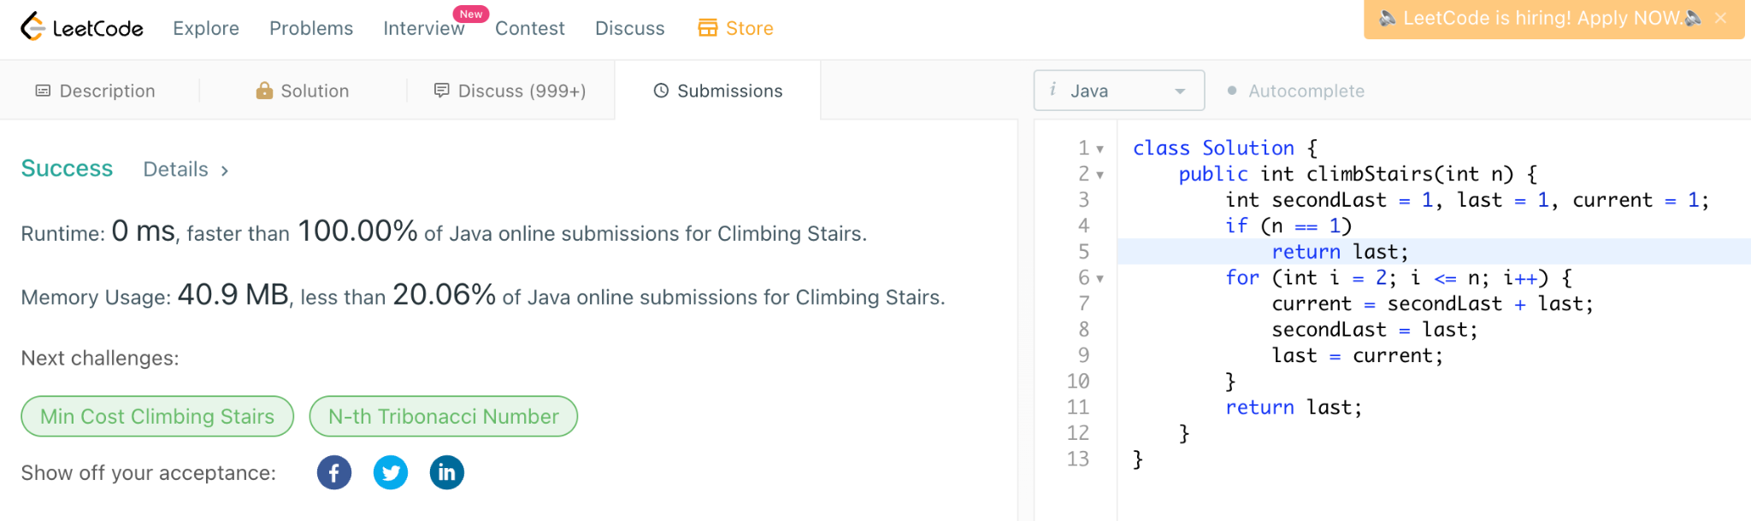
Fun Fact
The previous solution runs faster than 100% of leetcode solutions for the problem…which is the first time I have ever gotten a 100%...if you haven’t been convinced of the power of DP yet…you should be now…

Slide 33
Intro to Dynamic Programming
Fibonacci Problem
Staircase Problem
Box Problem
Knapsack Problem

Slide 34
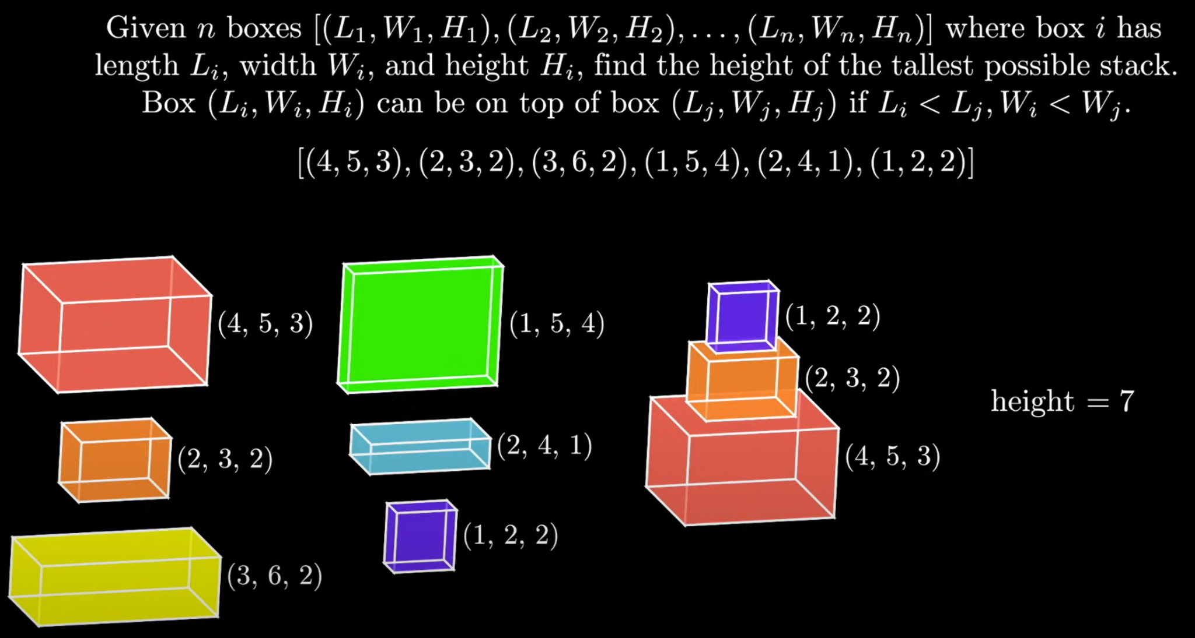

Slide 35
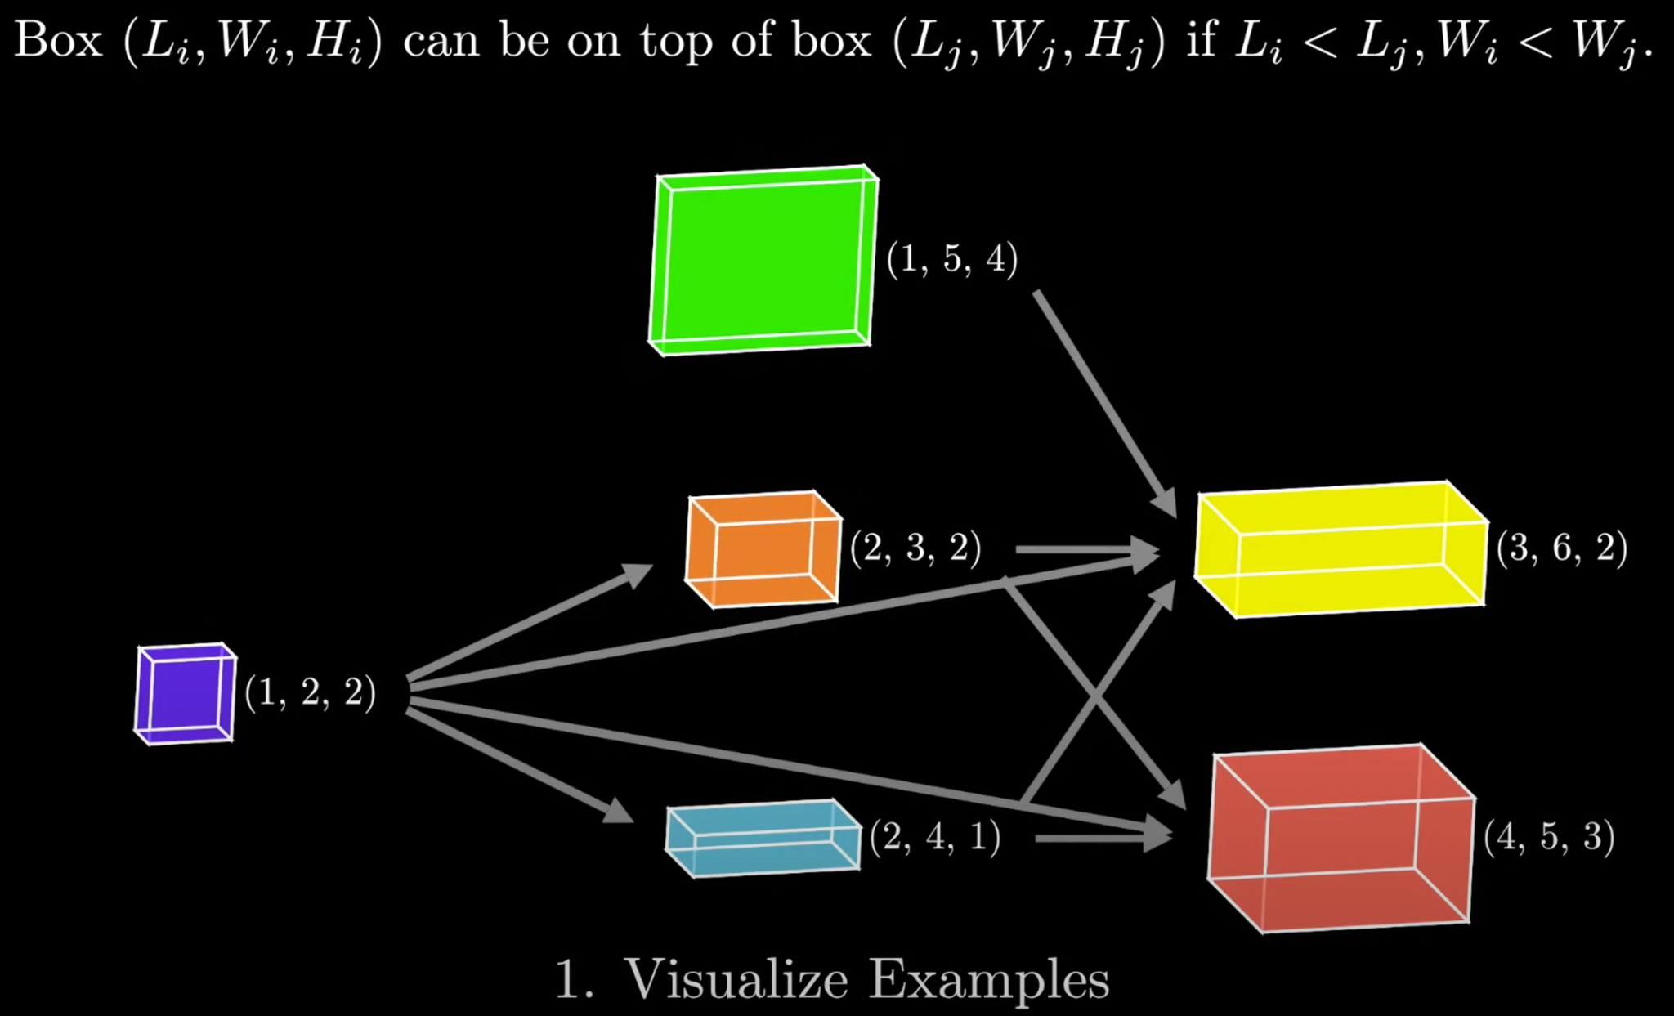
Use a DAG to visualize which box can stack on top of which

Slide 36
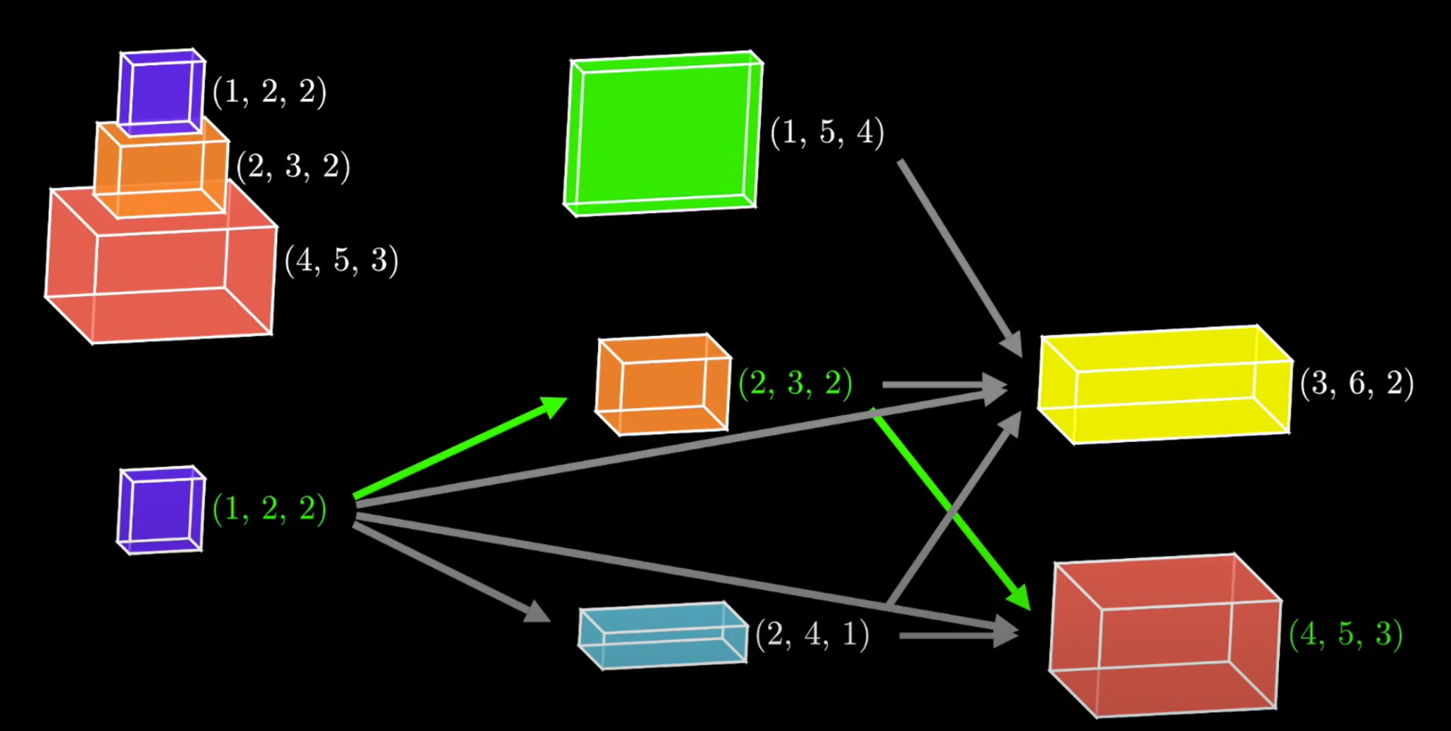
2. Identify sub problems: Paths in the DAG represent valid stacks

Slide 37
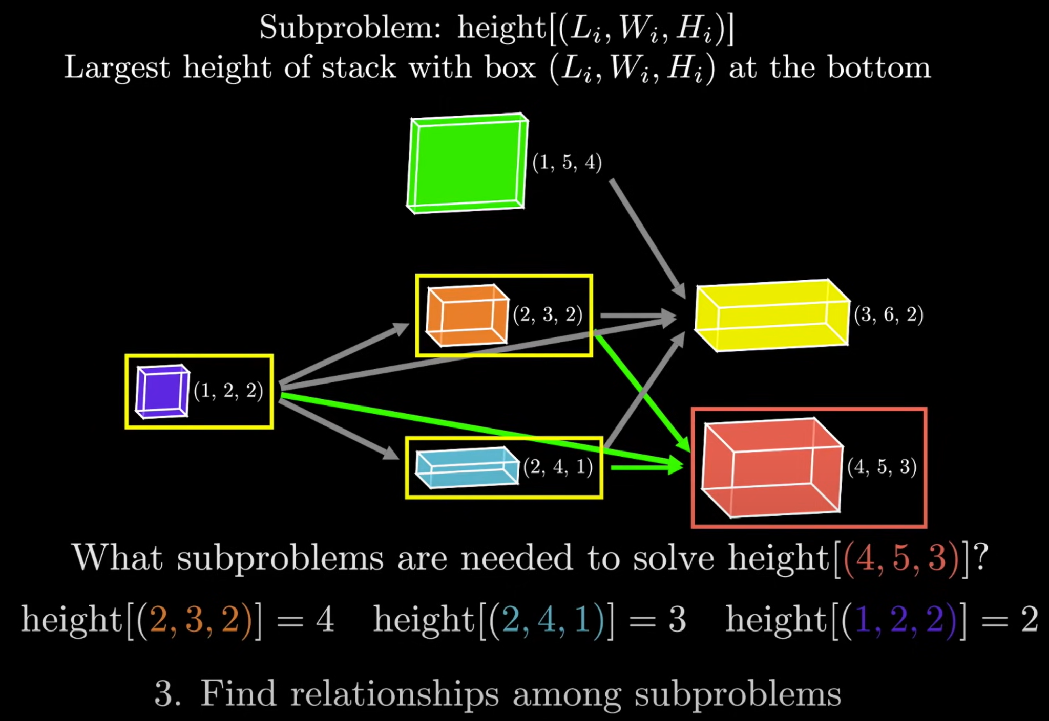
3. Find how subproblems build to larger solution

Slide 38
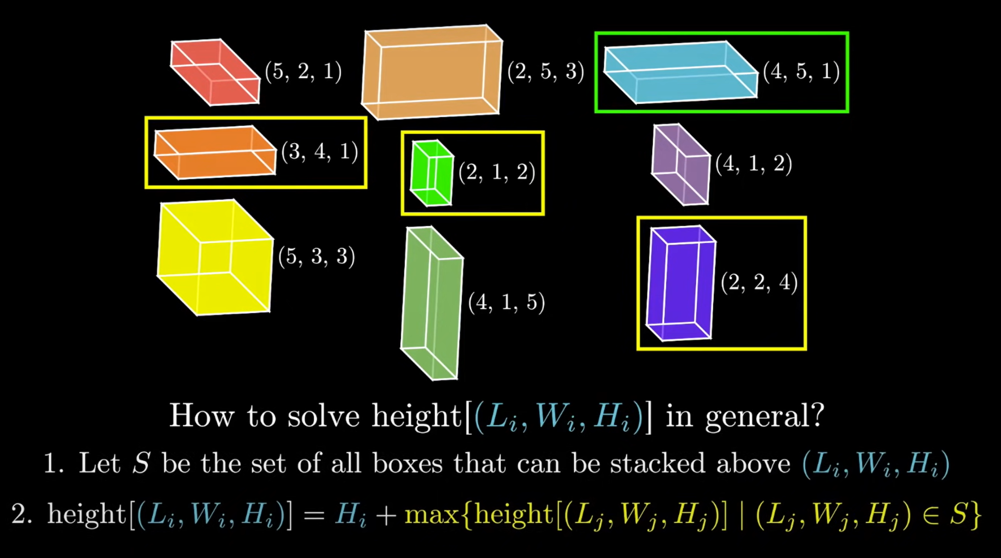
4. Generalize relationship between subproblems and final solution

Slide 39
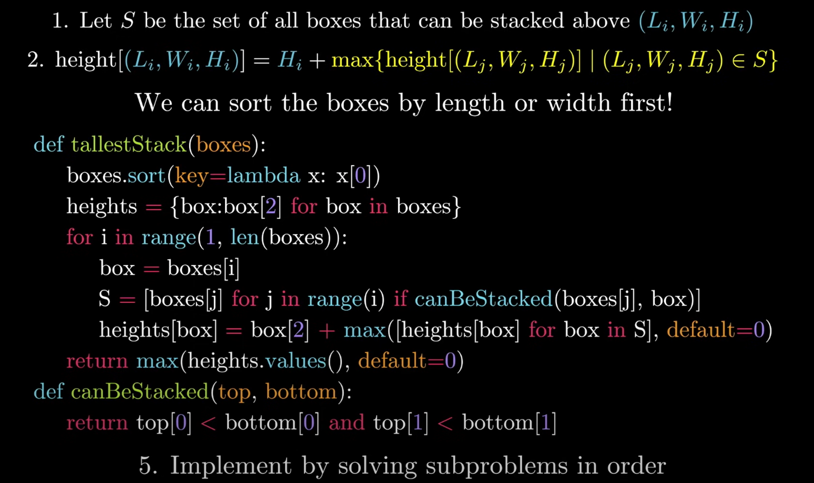
5. Implement solving subproblems in correct order

Slide 40
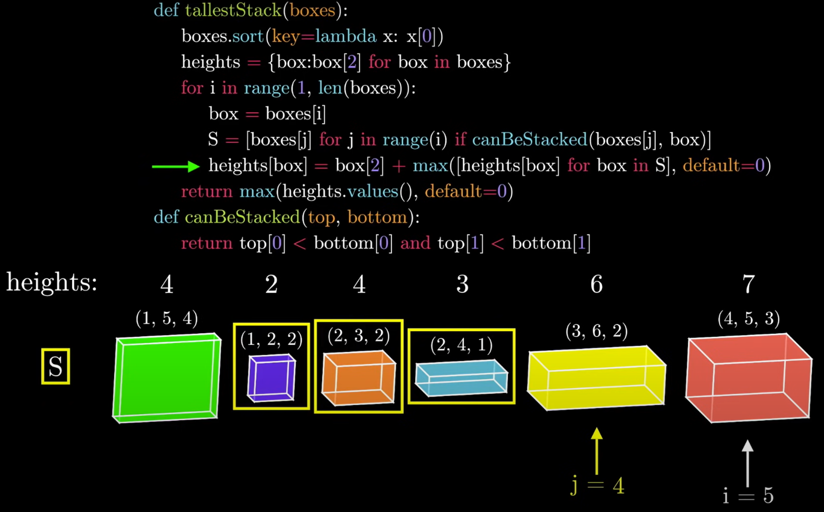

Slide 41
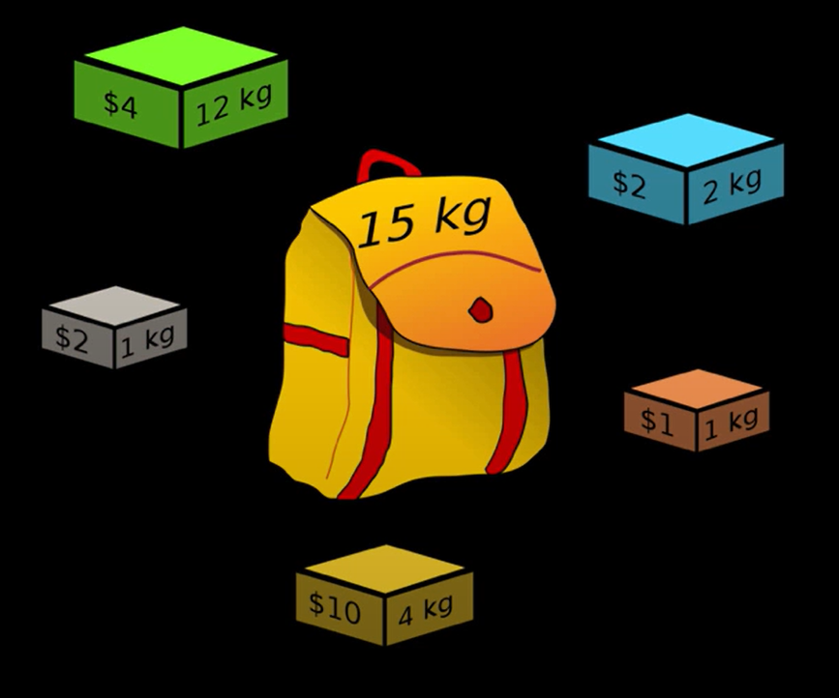
0/1 Knapsack Problem
Given a set of objects which have both a value and a weight (v_{i}, w_{i}) what is the maximum value we can obtain by selecting a subset of these objects such that the sum of the weights does not exceed the knapsacks given capacity?
Problem Walk Through Video

Slide 42
Intro to Dynamic Programming
Fibonacci Problem
Staircase Problem
Box Problem
0/1 Knapsack Problem

Slide 43
Brute Force Recursive Solution
public int knapsack(int n, int cap, int[] w, int[] v) {
if (n == 0 || cap == 0) {
result = 0;
} else if (w[n] > cap) {
result = knapsack(n-1, cap, w, v);
} else {
int temp1 = knapsack(n-1, cap, w, v);
int temp2 = v[n] + knapsack(n-1, cap - w[n-1], w, v);
result = Math.max(temp1, temp2);
return result;
}
}
O(2^{n})

Slide 44
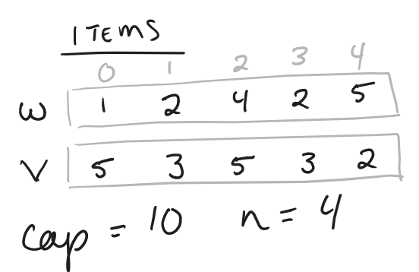
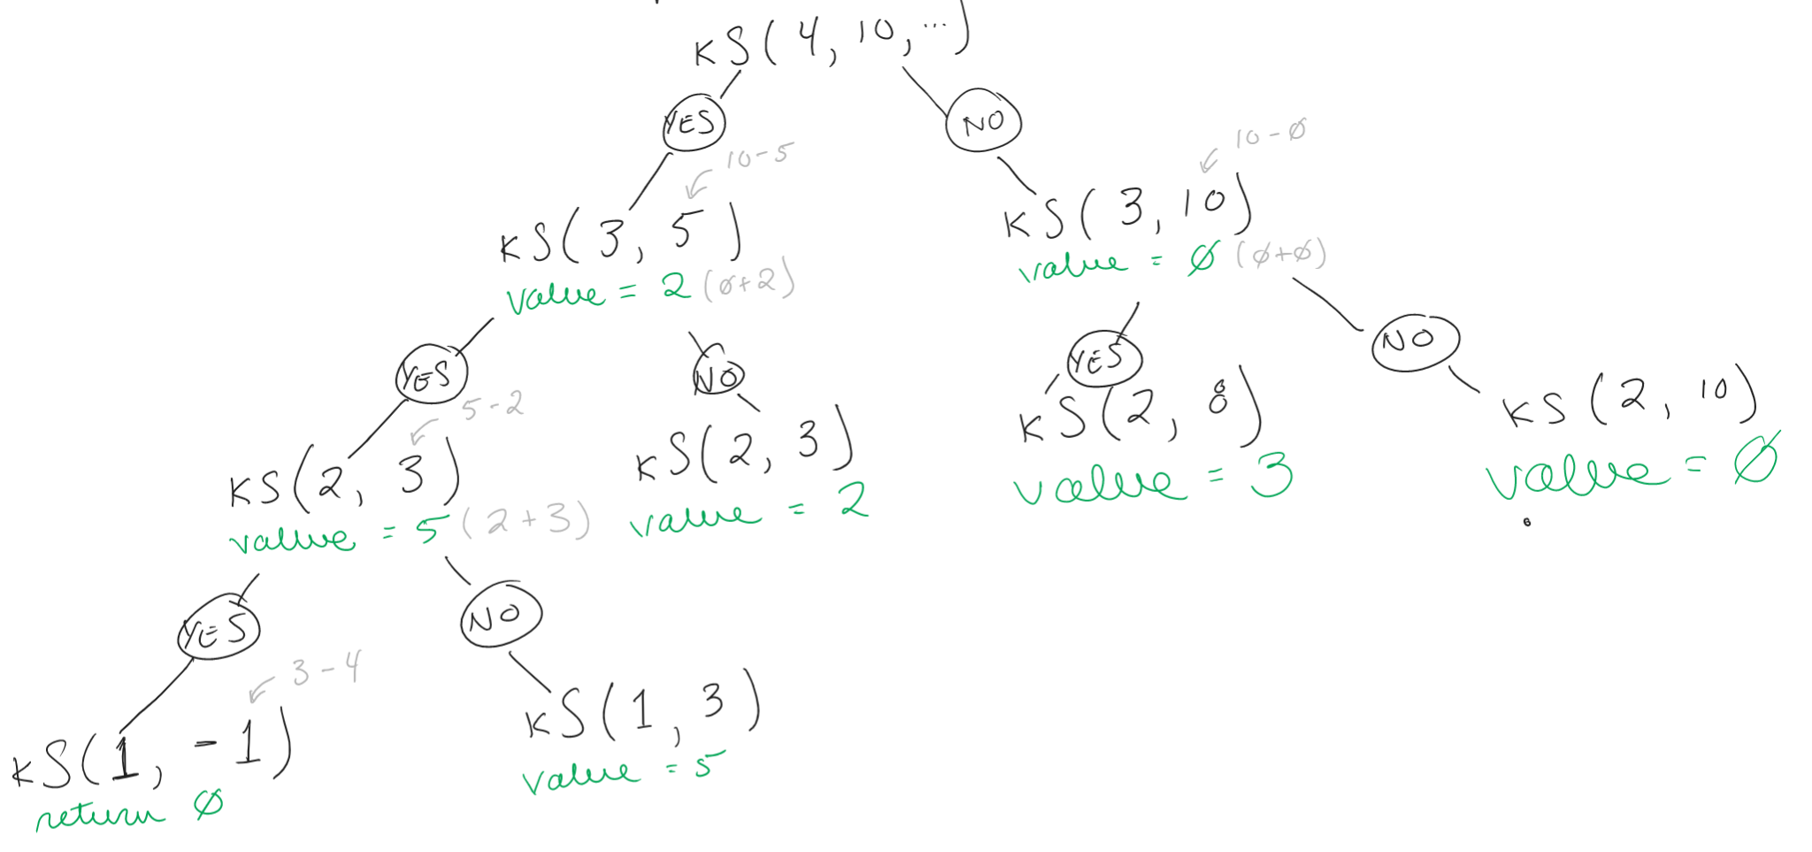
Recursive Solution is Exponential

Slide 45
Memoized DP Solution
public int knapsack(int n, int cap, int[] w, int[] v, int[][] memo) {
int result = memo[n][cap];
if (memo[n][cap] == NULL) {
if (n == 0 || cap == 0) {
result = 0;
} else if (w[n] > c) {
result = knapsack(n-1, cap);
} else {
int temp1 = knapsack(n-1, cap);
int temp2 = v[n] + knapsack(n-1, cap - w[n-1]);
result = Math.max(temp1, temp2);
memo[n][cap] = result;
}
}
return result;
}
O(n)

Slide 46
More Examples of Dynamic Programming Problems
Count the different ways to move through a 6x9 grid
Given a set of coins, how can we make 27 cents using the smallest number of coins?
Given a set of strings, what are the possible ways to construct the string “potentpot”
Knapsack problem
Helpful walk through videos:
5 Simple Steps for Solving Dynamic Programming Problems

Slide 48
That’s all!

